Slide 1

Marketing Committee
5 October 2016
09.00 – 12.30 hrs.
SIDE Hotel Hamburg
Room S

Slide 2
MEMBERS COMPLYING WITH COMPETITION LAW
In order to protect the interests of individuals and member companies, while active within Afera (in the broadest sense), the Competition Law policy should always strictly be followed.
1) Do not agree on nor discuss prices, (including price increases and pricing
methods), discounts, terms of sale, the refusal to deal with another company, or profit margins with any representative of any Afera member company;
2) Do not make announcements about your prices or those of
competitors;
3) Do not talk about the plans of individual companies (yours or
competitors’) regarding specific geographic or product markets or
regarding particular customers;
4) If in doubt consult the Associations’ staff or legal counsel.

Slide 4
Education Awareness – Status LV/ES
The focus has changed to the BTEC qualification, as opposed to degree level qualification
Parafix has provided the syllabus structure, including the mandatory and optional units, of three levels of Engineering related BTEC courses
The Technical Committee will determine where adhesive tape related content could be included
The Technical Committee will create the content and approach the exam board (ideally with Mike’s contact at iMeche)
If successful, this will be rolled out across Europe

Slide 5
- Membership recruitment – Converter list development, discuss attracting various member types, results membership satisfaction survey 2015/2016,
what to do about declining membership due to mergers

Slide 6
Help us help you
Friday, August 05, 2016

Slide 7
66
Total Responses
Date Created: Monday, February 15, 2016
Complete Responses: 53

Slide 8
Q1 & Q2: Name, Company, Function
See separate Word doc

Slide 9
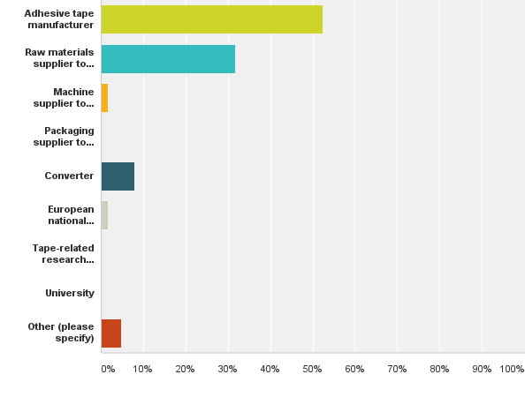
Q3: My organisation is a/an
Answered: 63 Skipped: 3

Slide 10
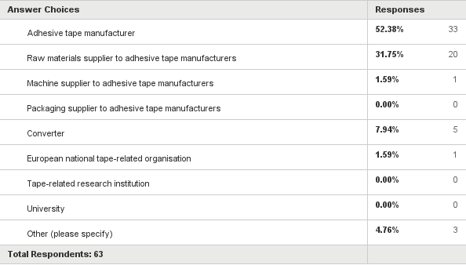
Q3: My organisation is a/an
Answered: 63 Skipped: 3

Slide 11
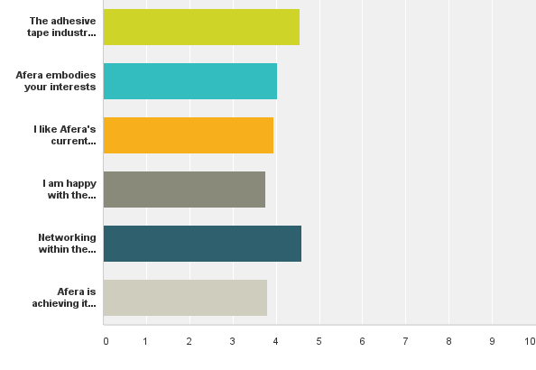
Q4: Please use the following scale to indicate how much you agree with the following statements: 0 (do not agree) - 4 (strongly agree)
Answered: 59 Skipped: 7

Slide 12
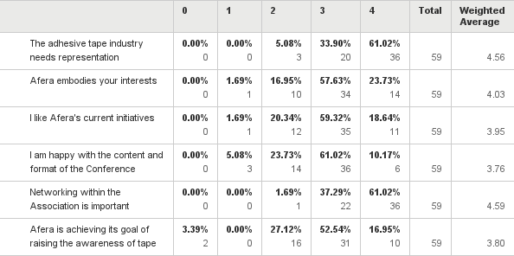
Q4: Please use the following scale to indicate how much you agree with the following statements: 0 (do not agree) - 4 (strongly agree)
Answered: 59 Skipped: 7

Slide 13
Q5: On a scale of 0 to 4 (0 = none, 4 = very much), what value would you place on Afera membership?
Answered: 63 Skipped: 3
0 = 0%
1 = 0%
2 = 6%
3 = 67%
4 = 27%

Slide 14
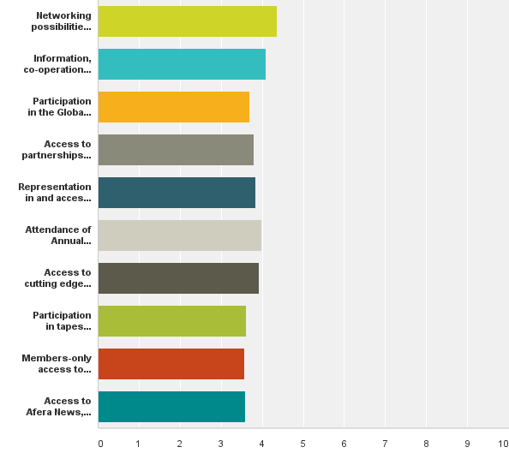
Q6: Why do you feel membership in Afera is important for your organisation?
Answered: 54 Skipped: 12

Slide 15
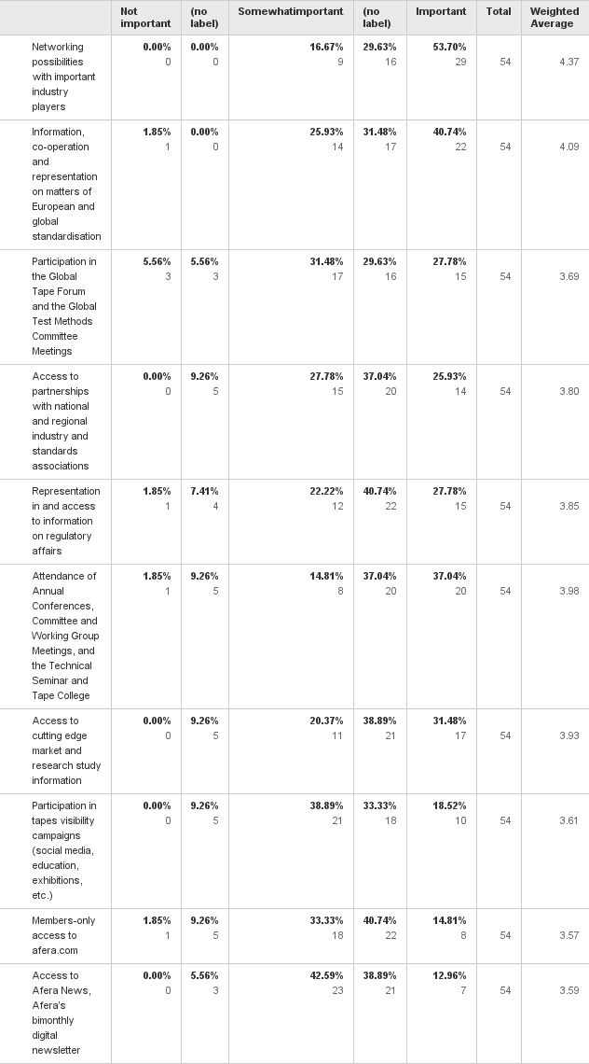
Q6: Why do you feel membership in Afera is important for your organisation?
Answered: 54 Skipped: 12

Slide 16
Q6: Why do you feel membership in Afera is important for your organisation?
Answered: 54 Skipped: 12

Slide 17
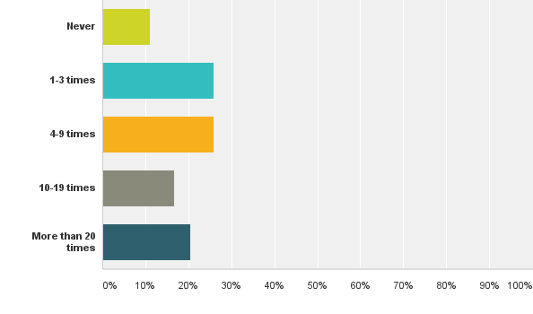
Q7: How many times has someone from your company (who is not on an Afera Committee) attended an Afera event?
Answered: 54 Skipped: 12

Slide 18
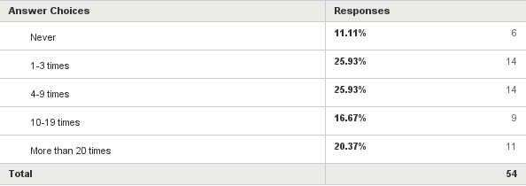
Q7: How many times has someone from your company (who is not on an Afera Committee) attended an Afera event?
Answered: 54 Skipped: 12

Slide 19
Q8: What European country/city is your prefered location for the Annual Conference?
COUNTRIES CITIES
Italy 12x Barcelona 5x
Germany 5x Munich 3x
Spain 3x Amsterdam 3x
Central/South 2x London 3x
France 2x Rome 3x
Portugal, Turkey, Austria, CH, UK 1x Brussels 3x
Cologne 2x
Athens 2x
Frankfurt 2x
Florence, warm location,
Budapest, Brigmingham, Antalya,
Paris all 1x
Remarks: Rotation as now is fine, should be easily reached by plan, international airport closeby

Slide 20
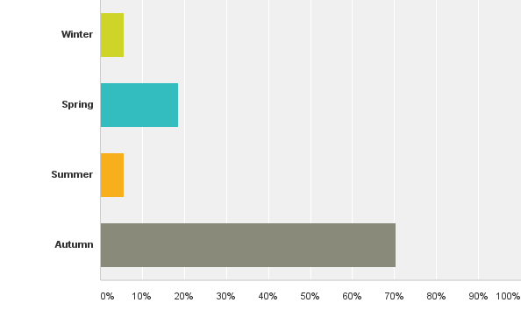
Q9: When would you prefer the Annual Conference to take place?
Answered: 54 Skipped: 12

Slide 21
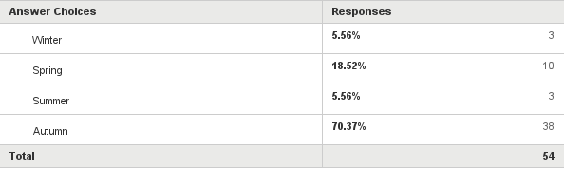
Q9: When would you prefer the Annual Conference to take place?
Answered: 54 Skipped: 12

Slide 22
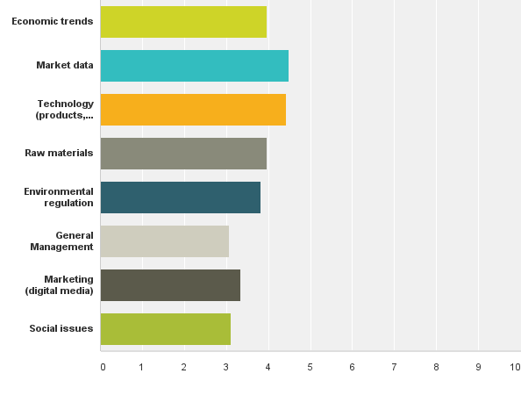
Q10: Please indicate theimportance of topicsyou would most like covered at the Annual Conference:
Answered: 54 Skipped: 12

Slide 23
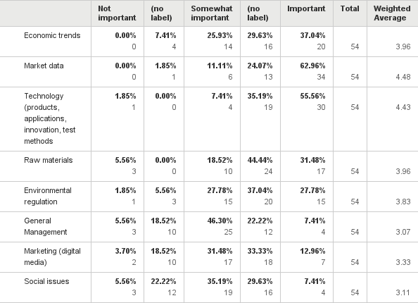
Q10: Please indicate theimportance of topicsyou would most like covered at the Annual Conference:
Answered: 54 Skipped: 12

Slide 24
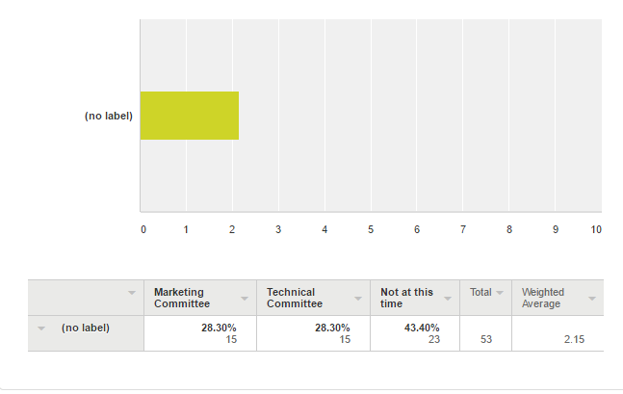
Q11: Would you be willing to invest time in one of Afera’s Committees?
Answered: 53 Skipped: 13

Slide 25
Q12: On a scale of 0 to 4 (0 = not at all, 4 = highly), how satisfied are you with Afera’s website, afera.com, in terms of content and user-friendliness?
0 0%
1 0%
2 3%
3 54%
3,5 1,5%
4 22,5%
7 1,5%
Skipped question 17,5%

Slide 26
Q13: In your opinion, how could Afera increase its membership value?
Being more strong in standards with Finat for example (Distrex)
Better networking possibilities, Afera should become a Quality guarantee for the products (Volz)
Market contacts (BOMA)
Find Multipliers within the companies who promote Afera (like in our company Evert Smit does) (Lohmann)
Afera should find ways to involve and represent more effectively the packaging tape industry and producers to maintain a central role in the industry (Dow Chemical)
Raw material presentations and information, market data (3M)
Offer a wider perspective of members/participants, covering the full value/supply chain (from raw materials to converters) and pyramid (high end to low end). (Nitto)
Give insights in interesting new technologies/ developments linked to adhesives (e.g. DUS/3D printing case) (Nitto)
Attracting more tape producers to the meetings, giving more precise data on the worldwide sales of tapes and market trends, decreasing also the participation fee to the congress for the tape producers. Often it is a meeting of raw materials suppliers (Ichemco)
it is right now on a high level (IVK)
More aggressive push of tape as technology to tape customers and, moreover, to non-tape users (Coroplast)
By promoting the use of adhesive tapes in as many forums as possible. (Miarco)
More converters (Parafix)
Afera should improve the technical content of the conferences such as PSTC to bring more value to the market (Organik)
Increasing the participation of Tape converters. Then we will have a better networking (Bostik)
1-Enabling strong network within members (tesa)
2-Informing upcoming regulatory issues
3-Creating platforms for penetrating the adhesive tape use in different segments and users
Take a proactive approach to raise AFERA's profile, for example: Have a presence at (large) manufacturing exhibitions and promote the virtues of adhesive tape. (Lohmann)
Parallel the PSTC tape conference (Scapa)
Carry on focusing, in relation to our industry, on topics like technology trends, raw material trends, regulation and social evolution which can affect in the future our industry. I appreciate the topics chosen in latest Afera conferences. (Sicad)
More lobbying in European Associations, More marketing activities and more presence in Social Media, More technical education for tapes (tesa)
More tape manufacturers could participate. (BASF)
More information on market data, global trends (outside of Europe) (Trocellen)
More public relation for the association (Consultant)
Get more involvement from OEMs / users (Automotive, electronics, building & construction etc.) (Ashland)
Afera should mostly lean on technical issues related with adhesive tapes such as preperation of MSDS, TDS, test conditions, regulatory affairs, etc with some present sampling documents to help us to prepare such documents for end users. (Süper Film)
1. qualified market data (Certoplast)
2. development of technique
3. development of countries
Trying to get more people to talk and share ideas. maybe a more interactive session could trigger the minds of the members (How to do it? Difficult! I think just review and try ideas). (Arizona)
Providing more Information in direction of tape user industry (Coroplast)
Invite big tape end-users to the conference like Automobile OEM's or big Players from the electronic market. (Mondi)
We are happy with Afera's present performance. (VITO Irmen)
Better market research data and tools to assist the industry (Atlas)
Initiation and coordination of exchange of topics within the supply chain (supplier, manufacturer, end user) (Artimelt)
Hosting events in conjunction with regional associations (Organik)

Slide 27
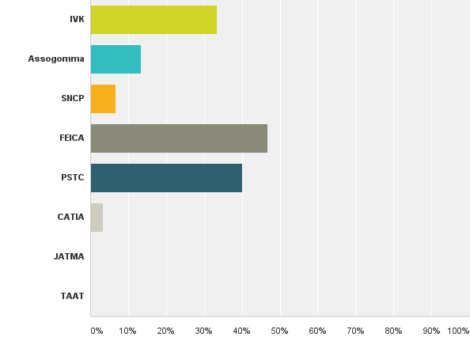
Q14: Which other industry (or related) associations are you a member of?
Answered: 30 Skipped: 36

Slide 28
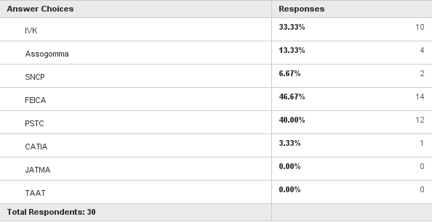
Q14: Which other industry (or related) associations are you a member of?
Answered: 30 Skipped: 36

Slide 29
Q15: Additional comments
To become a member in one of the committees it would be interesting to know how much work this will be. We are a afera member since one year and are interested to become a committee member but we need to know more about it. (Volz)
Overall I believe AFERA is doing a nice job, bringing together key players of the adhesive tape industry and giving insights in new evolutions.(Nitto)
The yearly membership fee of 2.200,- Euro is quite high.(Nippon)
Good Initiative...The more outside-in view we can get to improve AFERA the better (tesa)
Afera is on a good track with strong global impact.
More good market data for annual conference are needed. Question is: how to obtain it.
Afera should help us to solve some quality issues during production of adhesive tapes by technical committe and/or some consulting based organizations. (Süper Film)

Slide 30
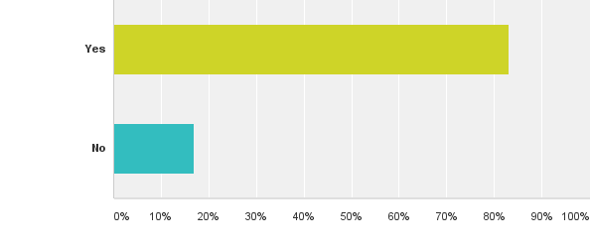
Q16: Would you allow us to contact you to discuss your point of view?
Answered: 53 Skipped: 13

Slide 31
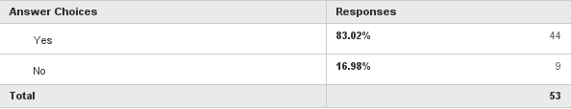
Q16: Would you allow us to contact you to discuss your point of view?
Answered: 53 Skipped: 13

Slide 32
- Annual conference – discuss how to improve dedicated input from MKC members to the conference programme in the future.

Slide 34
Update Report
October 2016
Website Management
working group

Slide 35

Contents
Actions completed since the last meeting
Statistics
What next?
What do we need from you?

Slide 36

Actions completed since the last meeting
Work has progressed on the two twitter accounts:
  @_ProductDesign where the target audience is designers and engineers who may or may not yet use tape
  @Afera_Tape where the target audience is both existing and potential new members of AFERA

Slide 37

Actions completed since the last meeting
@_ProductDesign
News items posting throughout the month (1 post per day).
News items consist of latest developments in design, materials and anything of interest relating to product design.
Posts linking to the Afera website have been limited to links to the designer interviews only so far. Future aim is to link to the “Why Tape” sections

Slide 39
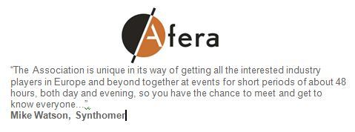
Actions completed since the last meeting
@Afera_Tape
Tweets have been scheduled based on news items sourced.
News items consist of industry developments & insights and member related items.

Slide 41

Actions completed since the last meeting
Website content:
A huge amount of work has been undertaken to rewrite the “Why Tape” section of the website
Several companies contributed content and images to build this section, so it is the result of a collective industry effort
The result is a 39 page document that will be available for all to review
Once final approval is received, then this will go live on the website and followers generated through the @_ProductDesign account will be linked to
this section of the AFERA website

Slide 42
Website Statistics
 | Jan | Feb | Mar | Apr | May | Jun | Jul | Aug | Sep
Visits 2016 | 2,146 | 2,384 | 2,193 | 2,293 | 2,040 | 2,056 | 2,105 | 2,165 | 2,561
New visitors % 2016 | 74.60% | 72.40% | 74.50% | 74.20% | 76.18% | 74.76% | 73.90% | 78.20% | 73.80%
Page views 2016 | 5,121 | 6,579 | 5,655 | 5,991 | 5,012 | 5,464 | 5,902 | 4,834 | 6,329
Pages / visit 2016 | 2.39 | 2.76 | 2.58 | 2.61 | 2.46 | 2.66 | 2.8 | 2.24 | 2.47
Avg time on page 2016 | 0:01:35 | 0:01:25 | 0:01:22 | 0:01:21 | 0:01:24 | 0:01:30 | 0:01:42 | 0:01:33 | 0:01:29
Avg session duration 2016 | 0:02:11 | 0:02:30 | 0:02:09 | 0:02:11 | 0:02:03 | 0:02:29 | 0:03:04 | 0:01:55 | 0:02:11
Bounce Rate % 2016 | 71.62% | 67.16% | 66.67% | 69.56% | 70.00% | 67.66% | 65.75% | 70.53% | 69.78%
Visits to member directory 2016 | 332 | 554 | 249 | 439 | 385 | 474 | 376 | 355 | 443
Banner clicks 2016 | 40 | 31 | 29 | 40 | 44 | 30 | 22 | 20 | 30
Referrals social media | 9 | 97 | 45 | 26 | 35 | 22 | 40 | 18 | 33
Notes:
Note that figures are based on no monthly SEO work, which will begin once Why Tape is complete.

Slide 43

What next?
Approve “Why Tape” section and link to design followers
Target social media contacts within existing member companies
Target new members
Consider more structured content plan which is outsourced, this will be subject to budget approval
Begin SEO work

Slide 44

What do we need from you?
  Feedback
  Social media contacts
  within your organisations

Slide 45
Thank you for your time
AFERA Website Management Working Group

Slide 46
2.805

Slide 47


Slide 48


Slide 49
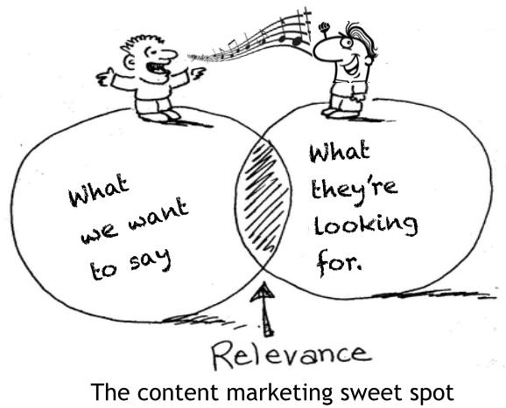
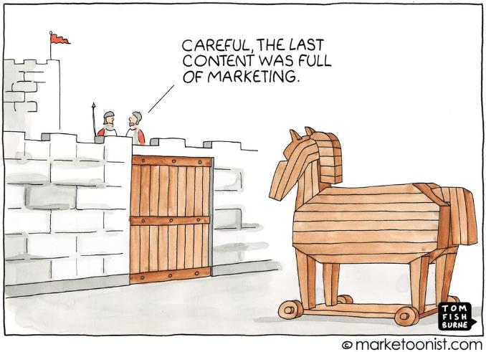

= DtS
= Why Tape

